Slide 1

School of Computer Engineering
Presentation for TY Mini Project (Review 3)
Brain tumor classification using CNN
Students Name:
Shyam Pandav(CETTYC66)
Devashish Nannaware(CETTYB17)
Prathamesh Kadam(CETTYB33)
Guided by :
Dr. Avinash Bhute

Slide 2
Index
Introduction
Literature survey
Problem Statement and Objectives
Block Diagram
Methodology
Algorithms
Analysis
Design/Implementation
Review Paper / Link
Conclusion
References

Slide 3
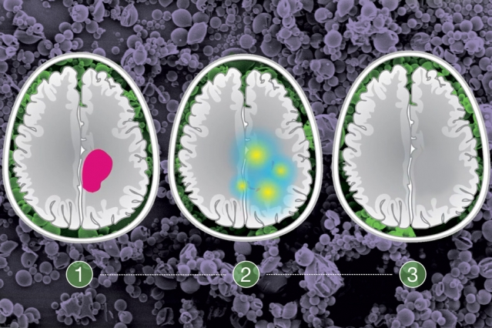
Introduction
Brain tumor is one of the vital organs in the human body, which consists of billions of cells. The abnormal group of cell is formed from the uncontrolled division of cells, which is also called as tumor. Brain tumor are divided into two types such low grade (grade1 and grade2) and high grade (grade3 and grade4) tumor.
Low grade brain tumor is called as benign.
High grade tumor is also called as malignant.
Benign tumor is not cancerous tumor.
Malignant tumor is a cancerous tumor. So it spreads rapidly . It leads to immediate death

Slide 4
Literature Survey
Author | Topic | Context | Future research
Debnath Bhattacharyya Tai-hoon Ki Springer-Verlag Berlin Heidelberg 2011 | Brain Tumor Detection Using MRI Image Analysis | In this paper, we propose an image segmentation method to indentify or detect tumor from the brain magnetic resonance imaging (MRI). | Huge amount of MRI image data needs Improve technique which leads to reduce time of radiologist Reduce human inspection for tumor in MRI image

Slide 5
Literature Survey
Author | Topic | Context | Future research
Ambeshwar Kumar a , Manikandan Ramachandran a , Amir H. Gandomi b,f Rizwan Patan c , Szymon Lukasik d,e , Ravichandran Kattur Soundarapandian a 2019 | A deep neural network based classifier for brain tumor diagnosis | To improve the early-stage brain tumor diagnosis via classification the Weighted Correlation Feature Selection Based Iterative Bayesian Multivariate Deep Neural Learning (WCFS-IBMDNL) technique is proposed in this work | Refining the parameter to get more effective and practical classification results. The use of more advanced machine learn- ing algorithms can also enhance brain tumor diagnosis progress further.

Slide 6
Problem statement
In day to day life scinerio many people are unaware of the brain tumor. If any case one of the person may having tumor in brain. Initially there are no such symptoms. If he/she going for checkup there having some processing time for declaring person having tumor or not.It also more harmful for that person.
Aim :
To develop model to classification of tumor using MRI image.
Objectives to be achieved
1. To study and identify the symptoms of brain tumor
2. To analyze the feasibility of brain tumor
3. To design and develop the classification model
4. To evaluate the performance for CNN

Slide 7
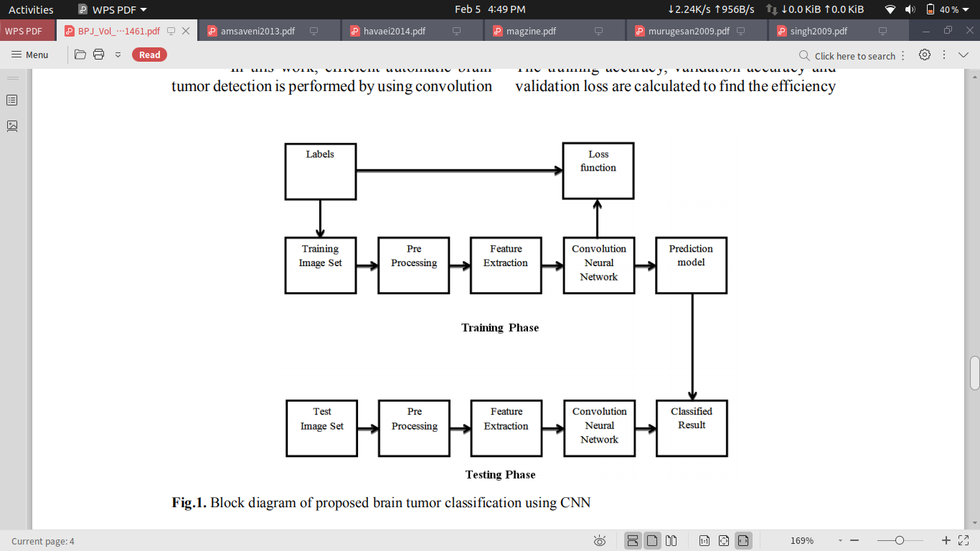
Block Diagram

Slide 8
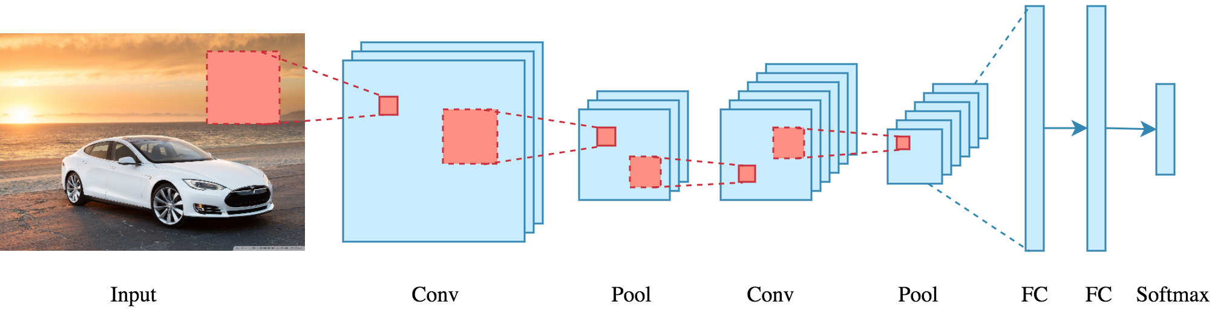
Architecture of CNN
Source : Towarddatascience

Slide 9
Methodology
Dataset collection
Prescreeing of MR images
Dataset splits into training dataset and testing dataset
Applying Image Processing to dataset (OpenCV)
Testing the accuracy of CNN
Improving correct detection of brain tumor

Slide 10
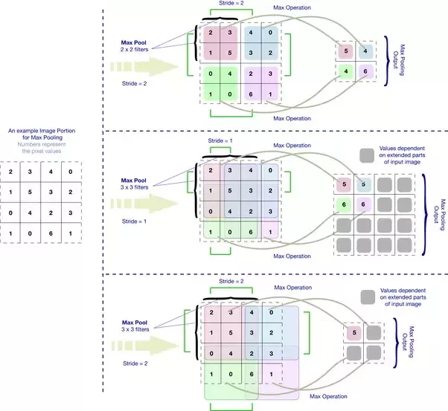
Analysis and Design
Source : Towards data Science

Slide 11
Confusion Matrix
Predicted
 | 'No' 19+12 | 'Yes' 247+3
'No' 22 | True 'No' 19 | False 'Yes' 3
'Yes' 259 | False 'No' 12 | True 'No' 247
Total number of 'No' = 22
Total number of 'Yes' = 259
Correct predicted 'Yes' = 247
Correct predicted 'No' = 19
Accuracy = 0.94
Actual

Slide 12
Algorithms
1. Data Collection :-
We collect MRI images from kaggle. We use labeled data that is making two folder of positive and negetive brain tumor images.
2. Data Augmentation :-
Importing all required libraries using Tenserflow backed. We make more copied of given images. Which helps to increase the accuracy of the model. In that data augmentation
process. We done the same number of copies that is positive and negative images of brain tumor. It helps to increase variance of model.
3. Data Processing :-
In order to crop the part that contains only the brain of the image, I used a cropping technique to find the extreme top, bottom, left and right points of the brain.

Slide 13
Algorithms
4. Load Up Data :-
First we read image from folder then crop the part of the image representing only the brain. After that we resize the image in standard resolution. Then apply normalization
because we want pixel values to be scaled to the range 0-1. Lastly append image to X and label to Y.
5. Splitting of Data :-
As we know we split data into 70% training 15% for Validation and 15% for testing phase.
6. Train the Model :-
We start training our model with 10 epochs. If we increase number of epochs which may increase accuracy but slow the computation of model

Slide 14
Implementation
Data Augmentation
"Number of examples: 2064"
"Percentage of positive examples: 52.51937984496124%, number of pos examples: 1084"
"Percentage of negative examples: 47.48062015503876%, number of neg examples: 980"

Slide 15
Implementation
Results Interpretation :-
Training Data:
Number of examples: 1445
Percentage of positive examples: 52.8719723183391%, number of pos examples: 764
Percentage of negative examples: 47.1280276816609%, number of neg examples: 681
Validation Data:
Number of examples: 310
Percentage of positive examples: 54.83870967741935%, number of pos examples: 170
Percentage of negative examples: 45.16129032258065%, number of neg examples: 140
Testing Data:
Number of examples: 310
Percentage of positive examples: 48.70967741935484%, number of pos examples: 151
Percentage of negative examples: 51.29032258064516%, number of neg examples: 159

Slide 16
Review Paper / Link
“Review Paper Link”
“Paper Presentation Link”
“Project Report Link”

Slide 17
Conclusion :
Our data contains tumor and non tumor MRI images with labelling.
Goal of this project is efficient automatic brain tumor classification with high accuracy.
We will try to achieve High performance and low complexity.
For reducing computing time we will use CNN.

Slide 18
References
1. Heba Mohsen et al, “Classification using Deep Learning Neural Networks for Brain Tumors”, Future Computing and Informatics, pp 1-4 (2017)
2. Stefan Bauer et al, “Multiscale Modeling for Image Analysis of Brain Tumor Studies”, IEEE Transactions on Biomedical Engineering, 59(1): (2012)
3. Sergio Pereira et al, “Brain Tumor Segmentation using Convolutional Neural Networks in MRI Images”, IEEE Transactions on Medical Imaging, (2016).
4. Kharrat A and Benamrane N, "Detection of brain tumor in medical images", IEEE Trans, Pattern Recog Vol 4, No 39, pp.no.1-6,2009.
5.Marcel Prastawa, Elizabeth Bullitt, Sean Ho, Guido Gerig “A brain tumor segmentation framework based on outlier detection” Medical Image Analysis, 8 (2004), 275-283.

Slide 19
Thank You!!
Any questions.

